Slide 2
Text & references:
0. Fundamentals of thermal-fluid sciences, 5th Ed., Yunus A. Cengel, et al. McGraw-Hill, 2017.
1. Understanding Thermodynamics, H. C. Van Ness, Dover, 1983.
2. Understanding Energy, R. S. Berry, World Scientific, 1991.
3. Thermodynamics, E. Fermi, Dover, 1956.
4. From Watt to Clausius, D. S. L. Cardwell, Iowa State University Press, 1989.
절대평가와 상대평가의 혼합형
수시시험(30%), 기말시험(30%), 과제물(40%, 8회 각 5%)

Slide 3
W01. 열역학 입문; 온도, 에너지, 효율
W02. 미시적 및 거시적 기술, 차원과 단위(과제 1)
W03. 기본적인 개념들, 상태, 성질
W04. 상태의 기술에 대한 가정, 열역학 제0 법칙(과제 2)
W05. 열역학 제1 법칙; 에너지 보존 법칙(과제3)
W06. 순수 물질의 성질
W07. 상태 평면과 포화 상태(과제 4)
W08. 닫힌 계의 에너지 해석(과제 5)
W09. 유동이 있는 계의 에너지 해석(과제 6)
W10. 열역학 제2 법칙
W11. 엔트로피, Carnot 사이클
W12. 이상기체의 엔트로피 변화(과제 7)
W13. Otto 사이클, 디젤 사이클
W14. Rankine 사이클(과제 8)
W15. 냉동 사이클과 열 펌프

Slide 4
Ch.5 Energy analysis of closed systems-0A
In Chapter 3, we considered various forms of energy and energy transfer, and
we developed a general relation for the conservation of energy principle or
energy balance. Then in Chapter 4, we learned how to determine the
thermodynamic properties of substances. In this chapter, we apply the energy
balance relation to systems that do not involve any mass flow across their
boundaries; that is, closed systems.
We start this chapter with a discussion of the moving boundary work or
work commonly encountered in reciprocating devices such as automotive
engines and compressors. We continue by applying the general energy
balance relation, which is simply expressed as , to systems

Slide 5
Ch.5 Energy analysis of closed systems-0B
that involve pure substance. Then we define specific heats, obtain relations for
the internal energy and enthalpy of ideal gases in terms of specific heats and
temperature changes, and perform energy balances on various systems that
involve ideal gases. We repeat this for systems that involve solids and liquids,
which are approximated as incompressible substances.

Slide 6
Ch.5 Energy analysis of closed systems-1
5-1 Moving boundary work
- Moving boundary work; quasi-equilibrium process is assumed
Fig. 5-0, 1, 2, 3, 4.
- net work done during a cycle; Fig. 5-5,
Ex. 5-1, 2(isobaric process), 3(isothermal process).
- Polytropic process; Fig. 5-9
- Spring work Ex. 5-4.

Slide 7
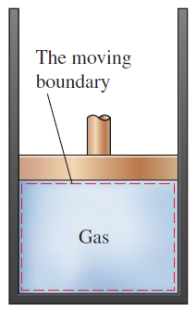
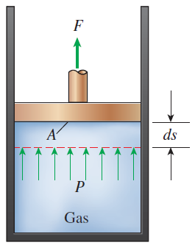
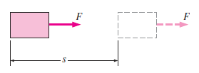
Ch.5 Energy analysis of closed systems-1a

Slide 8
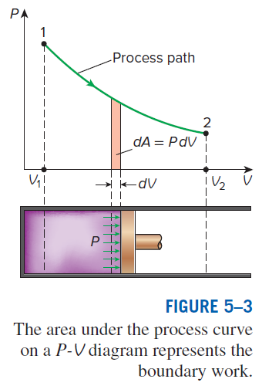
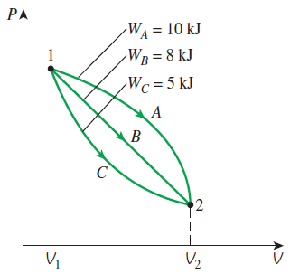
Ch.5 Energy analysis of closed systems-1b

Slide 9
Ch.5 Energy analysis of closed systems-1
5-1 Moving boundary work
- Moving boundary work; quasi-equilibrium process is assumed
Fig. 5-0, 1, 2, 3, 4.
- net work done during a cycle; Fig. 5-5,
Ex. 5-1, 2(isobaric process), 3(isothermal process).
- Polytropic process; Fig. 5-9
- Spring work Ex. 5-4.

Slide 10
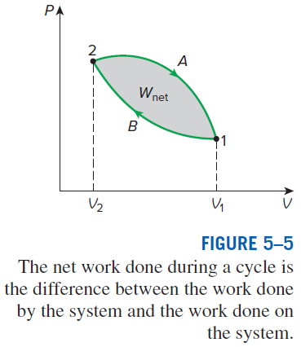
Ch.5 Energy analysis of closed systems-1c

Slide 11
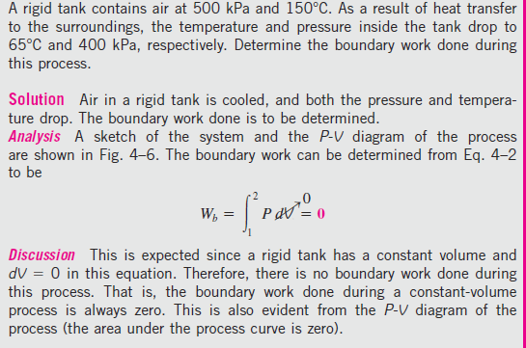
Ch.5 Energy analysis of closed systems-1d

Slide 12
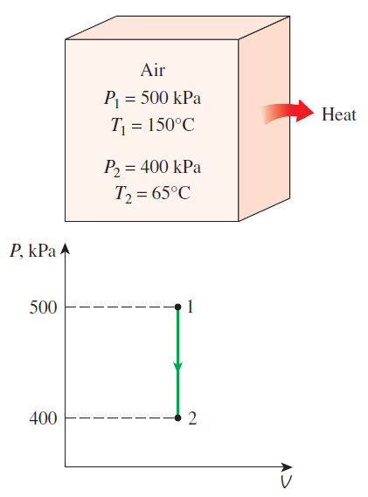
Ch.5 Energy analysis of closed systems-1e

Slide 13
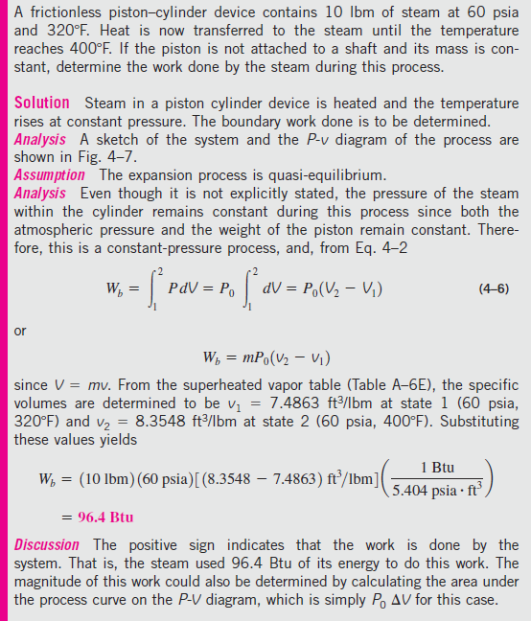
Ch.5 Energy analysis of closed systems-1f

Slide 14
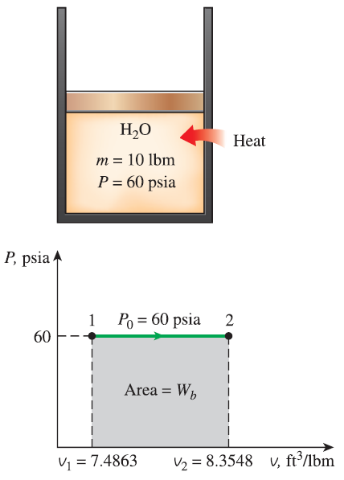
Ch.5 Energy analysis of closed systems-1g

Slide 15
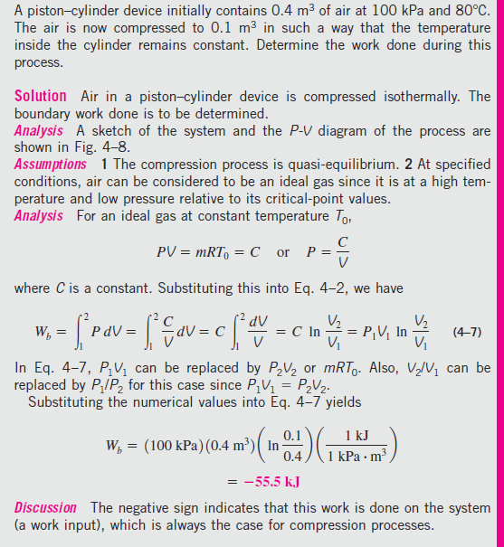
Ch.5 Energy analysis of closed systems-1h

Slide 16
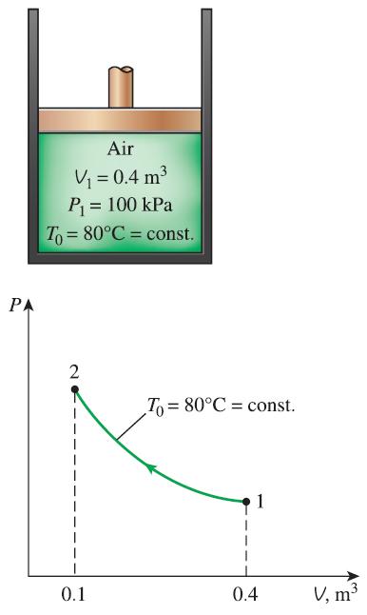
Ch.5 Energy analysis of closed systems-1i

Slide 17
Ch.5 Energy analysis of closed systems-1
5-1 Moving boundary work
- Moving boundary work; quasi-equilibrium process is assumed
Fig. 5-0, 1, 2, 3, 4.
- net work done during a cycle; Fig. 5-5,
Ex. 5-1, 2(isobaric process), 3(isothermal process).
- Polytropic process; Fig. 5-9
- Spring work Ex. 5-4.

Slide 18
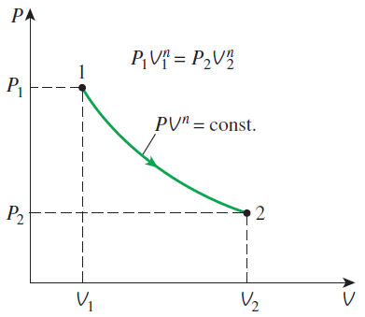
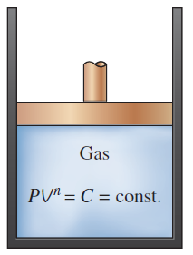
Ch.5 Energy analysis of closed systems-1j

Slide 19
Ch.5 Energy analysis of closed systems-1
5-1 Moving boundary work
- Moving boundary work; quasi-equilibrium process is assumed
Fig. 5-0, 1, 2, 3, 4.
- net work done during a cycle; Fig. 5-5,
Ex. 5-1, 2(isobaric process), 3(isothermal process).
- Polytropic process; Fig. 5-9
- Spring work Ex. 5-4.

Slide 20
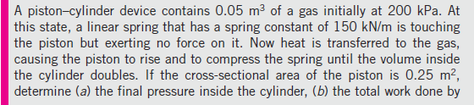
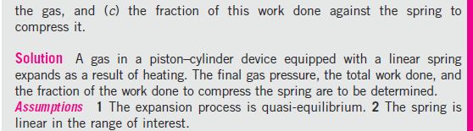
Ch.5 Energy analysis of closed systems-1k

Slide 21
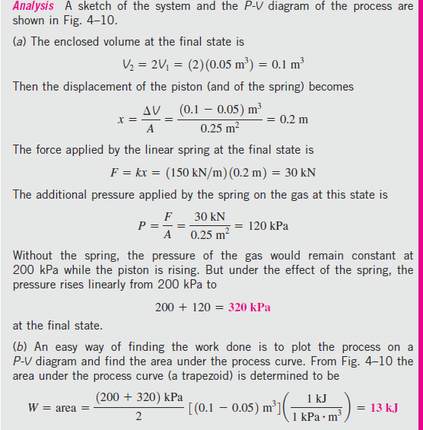
Ch.5 Energy analysis of closed systems-1l

Slide 22
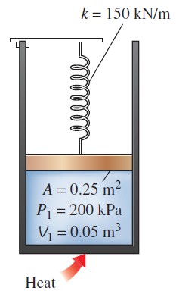
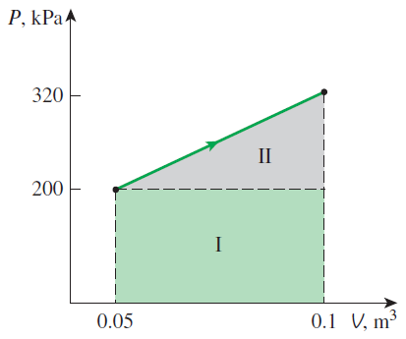
Ch.5 Energy analysis of closed systems-1m

Slide 23
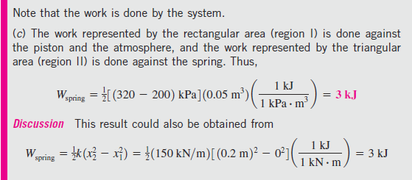
Ch.5 Energy analysis of closed systems-1n

Slide 24
Ch.5 Energy analysis of closed systems-2
5-2 Energy balance for closed systems

Slide 25
Ch.5 Energy analysis of closed systems-2a

Slide 26
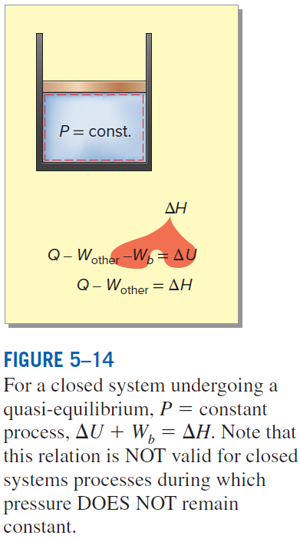
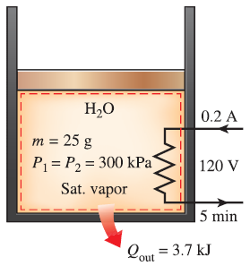
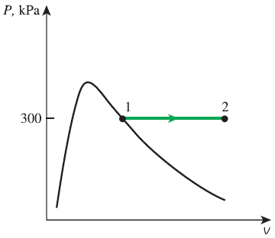
Ch.5 Energy analysis of closed systems-2b

Slide 27
Ch.5 Energy analysis of closed systems-2c

Slide 28
Ch.5 Energy analysis of closed systems-2d

Slide 29
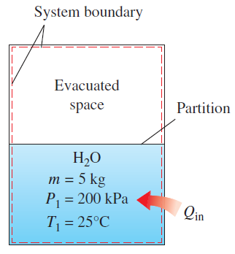
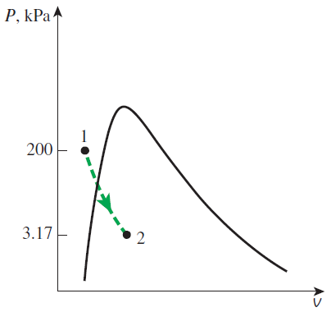
Ch.5 Energy analysis of closed systems-2e

Slide 30
Ch.5 Energy analysis of closed systems-2f

Slide 31
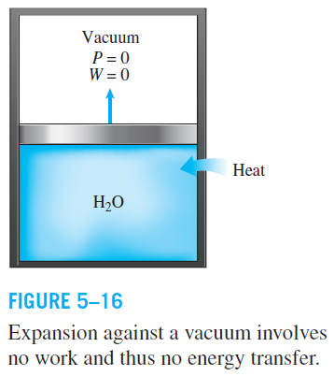
Ch.5 Energy analysis of closed systems-2g

Slide 32
Ch.5 Energy analysis of closed systems-2
5-2 Energy balance for closed systems

Slide 33
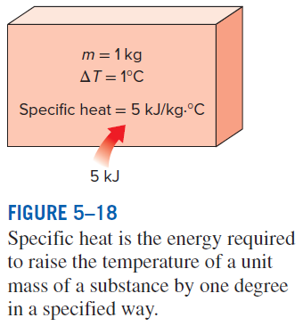
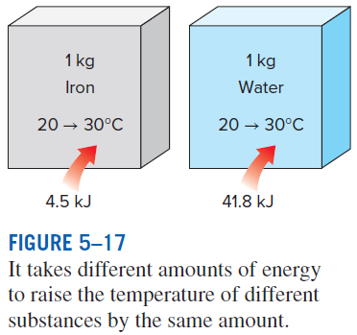
Ch.5 Energy analysis of closed systems-2h

Slide 34
Ch.5 Energy analysis of closed systems-3

Slide 35
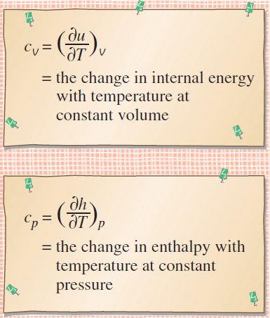
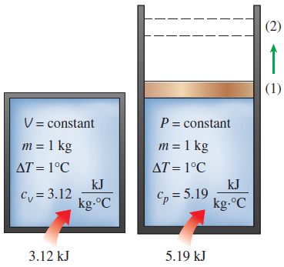
Ch.5 Energy analysis of closed systems-3a

Slide 36
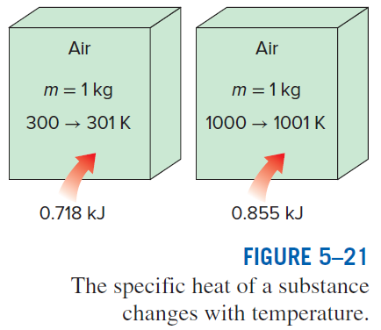
Ch.5 Energy analysis of closed systems-3b

Slide 37
Ch.5 Energy analysis of closed systems-4
5-4 Internal energy, enthalpy, and specific heats of ideal gases
- Joule(1843) showed, and as we have seen that, for ideal gases
Fig. 5-22, 23
Joule’s experiment
Fig. 5-24; Table A-2b, A-2c
Approximation
Fig. 5-26, 27, 28, 29
Ex. 5-7, 8, 9, 10

Slide 38
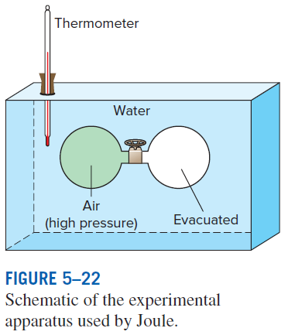
Ch.5 Energy analysis of closed systems-4a

Slide 39
Ch.5 Energy analysis of closed systems-4
5-4 Internal energy, enthalpy, and specific heats of ideal gases
- Joule(1843) showed, and as we have seen that, for ideal gases
Fig. 5-22, 23
Joule’s experiment
Fig. 5-24; Table A-2b, A-2c
Approximation
Fig. 5-26, 27, 28, 29
Ex. 5-7, 8, 9, 10

Slide 40
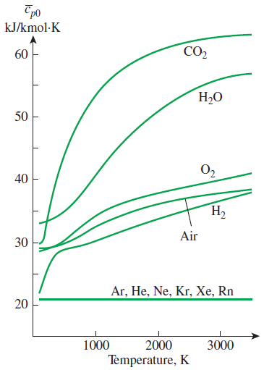
Ch.5 Energy analysis of closed systems-4b

Slide 41
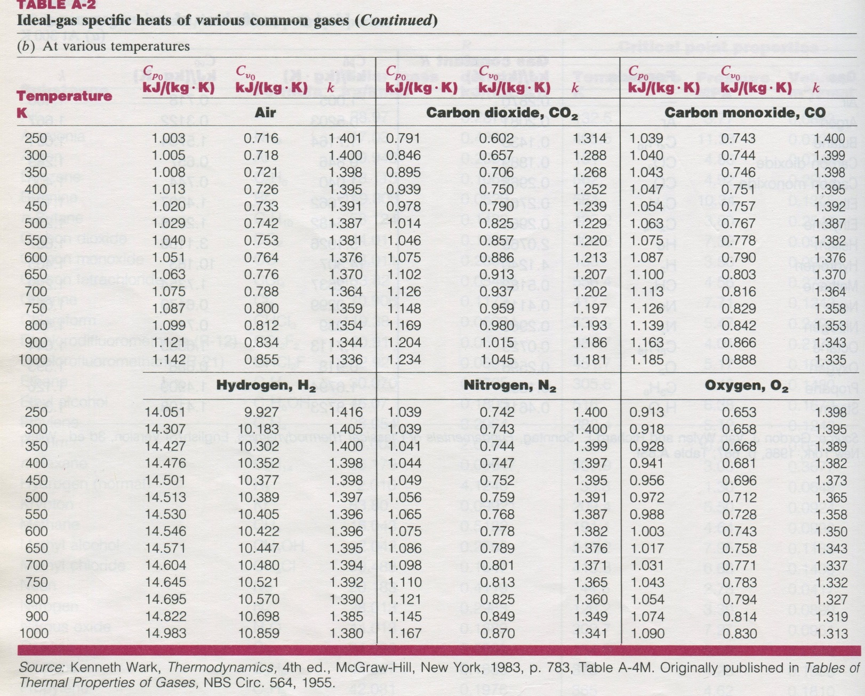
Ch.5 Energy analysis of closed systems-4c

Slide 42
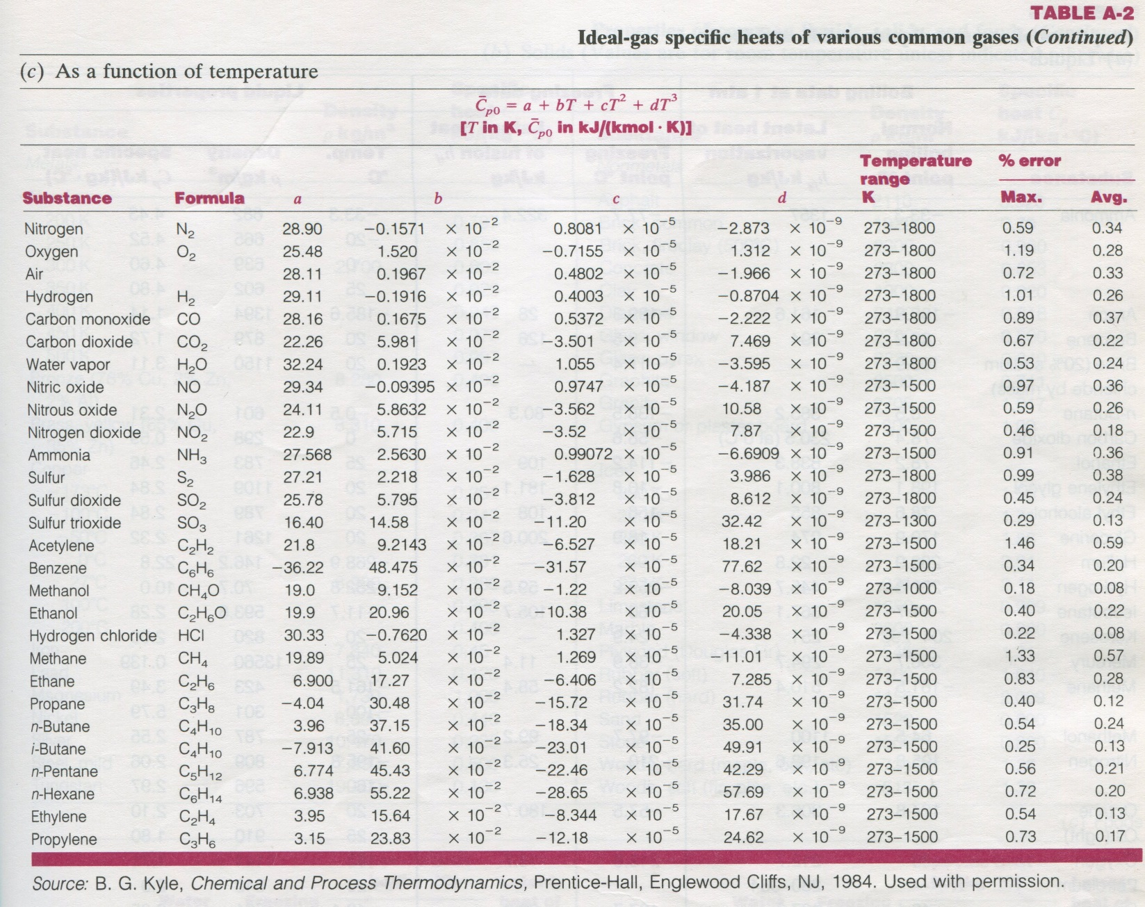
Ch.5 Energy analysis of closed systems-4d

Slide 43
Ch.5 Energy analysis of closed systems-4
5-4 Internal energy, enthalpy, and specific heats of ideal gases
- Joule(1843) showed, and as we have seen that, for ideal gases
Fig. 5-22, 23
Joule’s experiment
Fig. 5-24; Table A-2b, A-2c
Approximation
Fig. 5-26, 27, 28, 29
Ex. 5-7, 8, 9, 10

Slide 44
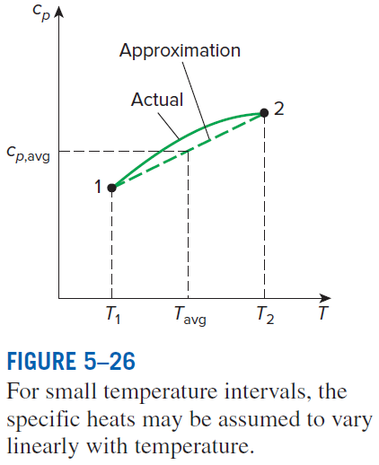
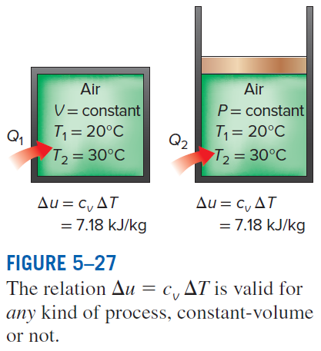
Ch.5 Energy analysis of closed systems-4e

Slide 45
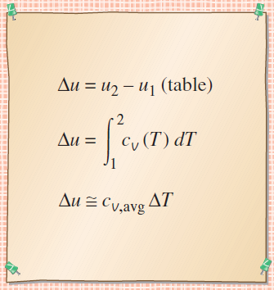
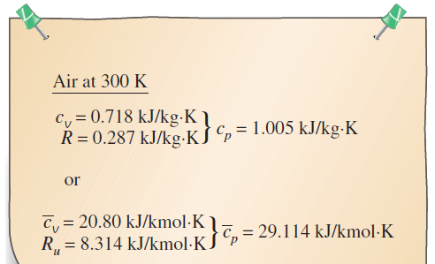
Ch.5 Energy analysis of closed systems-4f

Slide 46
Ch.5 Energy analysis of closed systems-4
5-4 Internal energy, enthalpy, and specific heats of ideal gases
- Joule(1843) showed, and as we have seen that, for ideal gases
Fig. 5-22, 23
Joule’s experiment
Fig. 5-24; Table A-2b, A-2c
Approximation
Fig. 5-26, 27, 28, 29
Ex. 5-7, 8, 9, 10

Slide 47
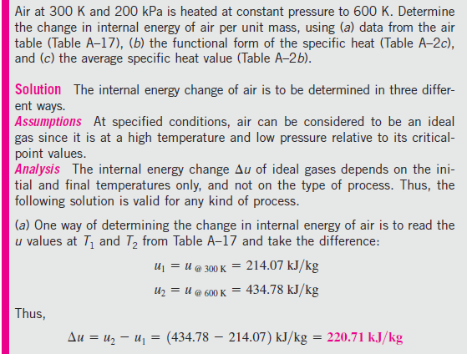
Ch.5 Energy analysis of closed systems-4g

Slide 48
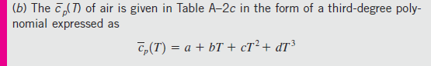
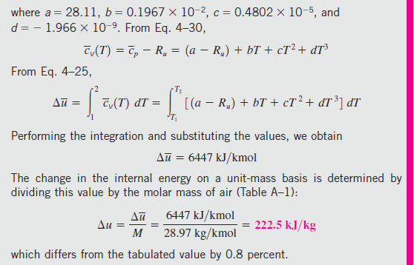
Ch.5 Energy analysis of closed systems-4h

Slide 49
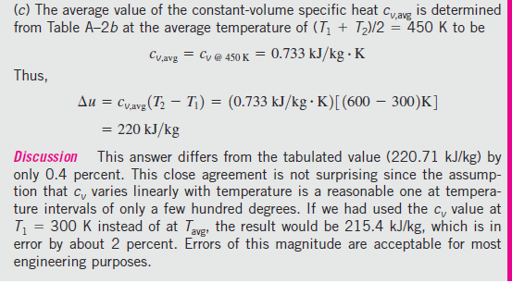
Ch.5 Energy analysis of closed systems-4i

Slide 50
Ch.5 Energy analysis of closed systems-4j

Slide 51
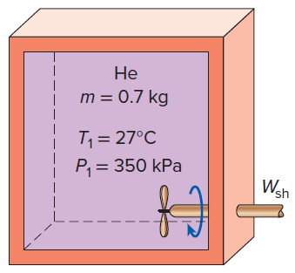
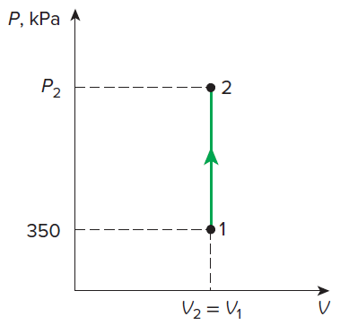
Ch.5 Energy analysis of closed systems-4k

Slide 52
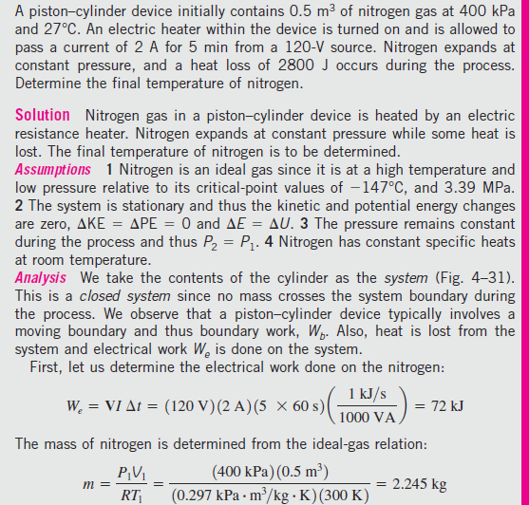
Ch.5 Energy analysis of closed systems-4l

Slide 53
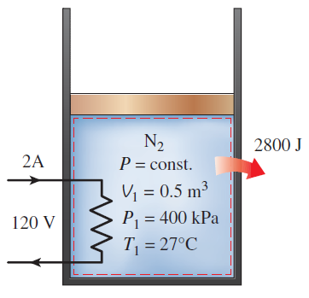
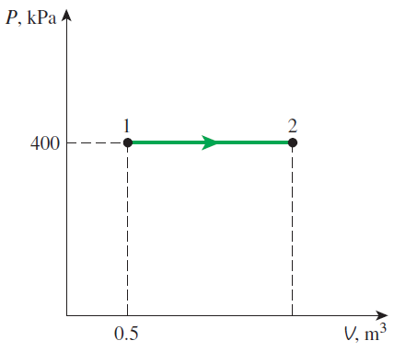
Ch.5 Energy analysis of closed systems-4m

Slide 54
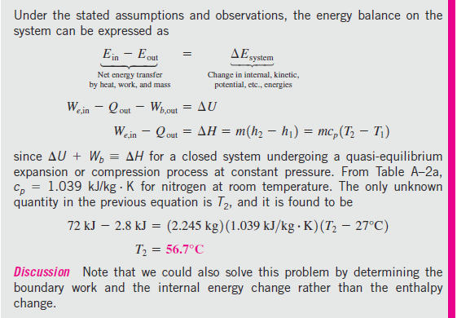
Ch.5 Energy analysis of closed systems-4n

Slide 55
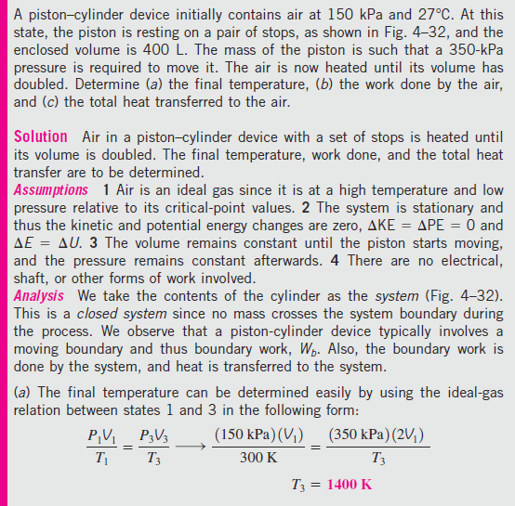
Ch.5 Energy analysis of closed systems-4o

Slide 56


Ch.5 Energy analysis of closed systems-4q

Slide 57

Ch.5 Energy analysis of closed systems-4p

Slide 58
Ch.5 Energy analysis of closed systems-4q

Slide 59
Ch.5 Energy analysis of closed systems-5
5-5 Internal energy, enthalpy, and specific heats of solids and liquids
- For incompressible substances as solids and liquids, we have
Table A-3
Fig. 5-33, 34; Ex. 5-12
HW Ch.5 Problems 6, 10, 22, 25, 32, 37, 50, 55, 62, 73, 79, 95, 112

Slide 60

Ch.5 Energy analysis of closed systems-5a

Slide 61

Ch.5 Energy analysis of closed systems-5b

Slide 62
Ch.5 Energy analysis of closed systems-5
5-5 Internal energy, enthalpy, and specific heats of solids and liquids
- For incompressible substances as solids and liquids, we have
Table A-3
Fig. 5-33, 34; Ex. 5-12
HW Ch.5 Problems 6, 10, 22, 25, 32, 37, 50, 55, 62, 73, 79, 95, 112

Slide 63


Ch.5 Energy analysis of closed systems-5c

Slide 64

Ch.5 Energy analysis of closed systems-5d

Slide 65

Ch.5 Energy analysis of closed systems-5e

Slide 66

Ch.5 Energy analysis of closed systems-5f

Slide 67
Ch.5 Energy analysis of closed systems-5
5-5 Internal energy, enthalpy, and specific heats of solids and liquids
- For incompressible substances as solids and liquids, we have
Table A-3
Fig. 5-33, 34; Ex. 5-12
HW Ch.5 Problems 6, 10, 22, 25, 32, 37, 50, 55, 62, 73, 79, 95, 112

